Slide 1
Staff Registered Campus Organizations Orientation
For FY 22-23 (August 2022 – June 2023)
Campus Life Services- Wellness and Community
Notes:
Add the following Line https://coronavirus.ucsf.edu/events

Slide 2
Agenda
Welcome to Staff RCO's FY23 Orientation!
Program Basics
Group Portal
Purchasing and Funding
Final Reminders
Questions

Slide 3
Staff Registered Campus Organizations (RCOs) enhance the staff experience by creating opportunities for the UCSF staff community to socialize on an individual, cultural, creative, and intellectual level while creating a sense of belonging and community.
Staff RCO Mission Statement

Slide 4
Program Basics

Slide 5
Program Basics
Meet the Team
Kathleen Yumul – Wellness Program Manager, Wellness and Community
Program administration
General questions and troubleshooting
Yolanda Marquez – Administrative Assistant, CLS Admin
Purchasing: BearBuy, P-Cards
Zac Concepcion – Project Manager, CLS Admin
Group Portal

Slide 6
Program Basics
RCO Period for FY23: July 15, 2022 – June 30, 2023
Last Day to Make Purchases: May 19, 2023
Unused funds do not roll over into the next FY
Spending down of funds is assessed for future applications
Only officers can make purchases
Fluidity with COVID-19 protocols
UCSF COVID-19 events status: https://coronavirus.ucsf.edu/events

Slide 7
Program Basics
Correspondence
Email: WellnessandCommunity@ucsf.edu
Subject Line: RCO Name – Subject
UC Oracles Toastmasters – Invoice for Supplies Purchase
Group Portal: Outgoing messages
Automated message reminders
Group messages

Slide 8
Registration
All staff RCOs must register each year with Wellness and Community
Registration for new and continuing Staff RCOs is open from June 1 – 30
*FY23: June 15 – July 15
1) Registration
2) Funding Application
Benefits
Apply for Funding
Request permission to fundraise
Reserve campus space

Slide 9
Registration Process
Staff RCOs must register annually June 1-30 for the fiscal year on the Group Portal (CampusGroups) website via MyAccess.
Group Name & Acronym
Categories
Logo
Website
Organization Email
Organization Goals
Summary of previous activities (description, attendance, cost) ** for renewals only
Four Officers ** all officers must have logged into Group Portal prior to registration
Terms & Agreement

Slide 10
New Registration Process (New Staff RCO)
How to video: https://player.vimeo.com/video/351696347
Log into Group Portal
Click on Group Directory symbol in the top navigation
Click on + All Groups
Click on Register New Staff Group ** only available in June
Fill out Group Registration Details:
Name, Category and Mission
Organization photo/logo
Four Officers
** in order to add them to the registration, they must have already logged into Group Portal at least once before
**each admin will be sent an automatic email asking them to fill out a confirmation form
Read and sign terms and agreements
Once completed, all officers will receive an email, click on form to submit confirmation
All officers must complete the officer confirmation form before registration can be processed

Slide 11
Renewal Registration Process
How to video: https://player.vimeo.com/video/351696353
Log into Group Portal
Navigate to your Group
Read the blue box and click on Group Re-Registration
Review all fields:
Add four officers
Answer registration questions
Read and sign terms and agreements
Once completed, all officers will receive an email, click on form to submit confirmation
All officers must complete the officer confirmation form before registration can be processed

Slide 12
FY23 Staff RCO Cycle Timeline
Jun. 15 – July 15, 2022
Open Registration
Aug. 2, 2022
Orientation Session
Aug 2022
Implementation
June 1, 2023
Application Opens for FY23
June 30, 2023 End of FY24 Cycle
May 19, 2023
Last Day to Make Purchases

Slide 13
Group Portal

Slide 14
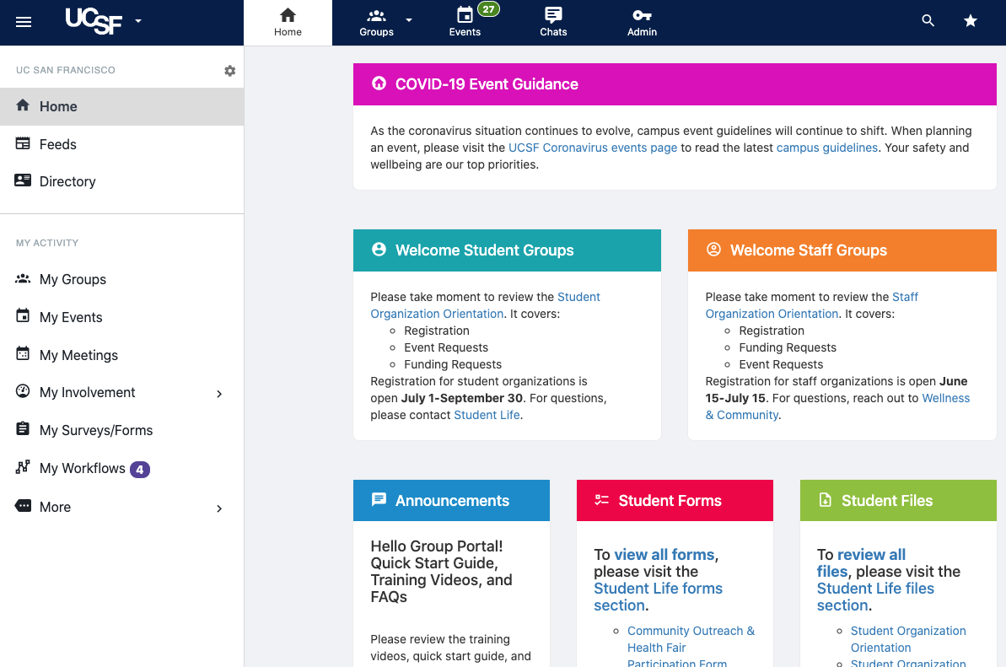
Group Portal
One stop shop for all your Staff RCO needs
All Staff RCOs have access
Groups.ucsf.edu or through MyAccess
Activating a Group Portal Account = Log in once

Slide 15
Group Portal - Events
General Info
All events on-campus, off-campus, or virtual must be submitted by a currently registered RCO officer in the Group Portal for approval in the “Events” section two weeks prior to event date
Events not submitted two weeks prior to the event date, may not be approved or receive the requested room, equipment, etc.
By creating an event, you will be able to:
Request Wellness and Community approval
Reserve on-campus classrooms and Special Use Areas
Submit table and chair requests (*limits apply)
On-campus classroom space may only be reserved through the event request submission in the Group Portal
Notes:
One thing we are emphasizing this year is that All events on-campus, off-campus, or virtual must be submitted by a currently registered RCO officer in the Group Portal for approval in the “Events” section two weeks prior to event date
Events not submitted two weeks prior to the event date, may not be approved or receive the requested room, equipment, etc.
Creating an event allows you to:
Request Wellness and Community approval
Reserve on-campus classrooms and Special Use Areas
Submit table and chair requests (*limits apply)
Allows us to have an accurate count of all the events your RCO is hosting and makes the events searchable to all staff on the GP page
Some of you may be used to reserving classroom space through 25Live directly, but if you are reserving classroom space on behalf of your RCO, you need to use GP to make the reservation moving forward
GP is tied to 25Live and each approved RCO will have an profile through 25Live specifically for their RCO

Slide 16
Group Portal: Events
Space Reservations
Review prior to reserving space https://coronavirus.ucsf.edu/events
Classrooms & Special Use Areas
Reserve space through Group Portal (see previous slide for steps)
Conference Centers & Meeting Spaces (“Off-Campus”)
Faculty Alumni House: louis.gutierrez@ucsf.edu
Lange Reading Room: micquel.little@ucsf.edu
Millberry Union Conference Center: Conference.Services@ucsf.edu
Mission Bay Conference Center: Conference.Services@ucsf.edu
Notes:
REVIEW: https://coronavirus.ucsf.edu/events
Policy for RCO/Student Organization requests
No classroom usage charge for RCO/Student Organization requests, such as high school outreach symposia/conferences (ie: Annual High School Outreach Conference). Charges for onsite technical support and other audio-visual services may apply. Contact Educational Technology Services for additional information
Policy for Staff Sponsored events with headcount of 40 or more attendees:
No charges for events that are less than 4 hours
No charges for staff sponsored events with headcount under 40 attendees
Classroom usage charges will apply to events with 75% non-UCSF attendees for events that are 4 hours or more. The charge would be $240 per lecture hall. Breakout rooms at no charge based on availability

Slide 17
Group Portal: Events
Potential Additional Fees
Weekend room reservations requiring room unlocks
Room reconfiguration
ETS (Educational Technology Services) Fees
ETS Fee Rates: https://edtech.ucsf.edu/rates
Tech support, audio set up, video set up, livestream, capture, etc.
Equipment rentals: https://edtech.ucsf.edu/equipment-rentals
Facilities charges for cleaning post-event
Tables, chairs, and other facilities requests
Indicate these additional add-on items when completing your event registration
Event policies are subject to changing UCSF COVID-19 event protocols
Notes:
Staff RCOs are responsible for requesting and paying for all facility requests (e.g. table, chairs, custodial services, unlocking doors, etc).
Have a section in the Events form where you will be able to add notes that you need any of these additional items

Slide 18
Group Portal: Events
Event Reservations for Classroom Spaces
Classrooms lock at 6 p.m. on weekdays and locked on weekends/holidays. There is a fee to request classrooms unlocked.
Each academic quarter must be submitted separately
Fall 2022 Reservations Begin: July 8
Winter 2023 Reservations Begin: December 2
Spring 2023 Reservations Begin: February 21
Summer 2023 Reservations Begin: April 21
(subject to change)

Slide 19
Group Portal: Events
Steps for Submitting Event Request
To submit an event request:
Login to Group Portal
Navigate to your organization
Click on “Events” in your organization portal
Click on “Create an Event”
Click on “On-Campus Space Reservation” under location section if you wish to reserve a classroom or Special Use Area
Fill out each page of the event request until you click on “Submit”
Space must be booked through Group Portal, which will be automatically reserved in 25Live
Staff organizations may submit an event request for an in-person event, if the event meets the criteria outlined in https://coronavirus.ucsf.edu/events
How to video:
https://player.vimeo.com/video/351696374
Notes:
REVIEW: https://coronavirus.ucsf.edu/events
For promotional use and gain more user visibility
Make sure to also submit Event Request Form aka “Event Information”
SEPARATE ITEMS:
Alcohol request
Fundraising request
For any RCO recreational in nature, waivers must be filled out each year. Waivers can be filled out in the Forms section.

Slide 20
Group Portal: Events
Accessibility Considerations
Review the entire Events Accessibility Guide online
https://studentlife.ucsf.edu/events-accessibility
Venue (accessible entrances, ramps, elevators, and accessible restrooms, reserved seating, interpreters, or captioning)
Food (allergen free foods, post common allergens)
Presentation (large format, captioned videos, describe visual aids)
Marketing (include the following accessibility statement)
To request an accommodation for this event, please contact [insert program/event contact person] at [insert program/event contact’s person’s email address] or [insert program/event contact’s person phone number] by [insert date, typically at least one week in advance].
Notes:
Highlights of the Events Accessibility Guide are below.
Include an accessibility statement on all event registration forms, fliers, electronic and print communications.

Slide 21
Group Portal: Events
Cancellations
If you wish to cancel an event, please DO NOT delete the event request in the Group Portal
To cancel the event, send an email to Wellness and Community at WellnessandCommunity@ucsf.edu
Depending on time of cancellation, fees for any add-on charges may not be refundable
Notes:
Need to monitor any event fees that nee

Slide 22
Group Portal: Events
Event Liability
Most on-campus RCO events are covered by the University insurance program. Please review the activities insurance chart online determine which activities are covered and which activities your RCO will be required to purchase insurance through Campus Connexions. ** fees may apply
RCO events that are held off-campus are not covered by the University insurance program and RCOs are able to purchase insurance through Campus Connexions. ** fees will apply
For any RCO participating in a recreational activity, each participant must sign a waiver
Notes:
Need to monitor any event fees that nee

Slide 23
Group Portal: Training Videos
How-To Videos
Please review the following training videos.
Group Portal Introduction
Managing Your Organization in the Group Portal
Registering a New Student Group in the Group Portal
Renewing a Student Group in the Group Portal
Submitting an Event Request in the Group Portal
**includes how to request classroom space, table/chairs, bake sale requests

Slide 24
Funding and Purchasing Guidelines

Slide 25
Funding Application
Funding applications will be accepted once a year and between June 1-30. *For FY23, applications were accepted from June 15– July 15.
Funding applications must be submitted in Group Portal
Link to Funding Application: http://cglink.me/s29968
All four officers from each RCO must attend a scheduled RCO orientation. Funding will not be approved if an officer is not in attendance.

Slide 26
Funding Application
One funding application per RCO due in Group Portal between
June 1-30. *For FY23, applications were accepted from June 15– July 15.
Include all events/programs for the year
Describe how events/programs align with PRIDE Value tenants
Describe organizational goals for the year
Provide estimate of membership numbers
Confirmed understanding of funding template.
Reviewed the Staff RCO orientation presentation
Upload itemized funding proposal
Must use template: Link to funding template
We encourage your organization to seek funding from additional campus sources in addition to the general RCO Funding.
Notes:
Event requests do not need to be submitted until event logistics are finalized.
PRIDE:
Professionalism: To be competent, accountable, reliable and responsible, interacting positively and collaboratively with all colleagues, students, patients, visitors and business partners.
Respect: To treat all others as you wish to be treated, being courteous, kind and acting with utmost consideration for others.
Integrity: To be honest, trustworthy and ethical, always doing the right thing, without compromising the truth, and being fair and sincere.
Diversity: To appreciate and celebrate differences in others, creating an environment of equity and inclusion with opportunities for everyone to reach their potential.
Excellence: To be dedicated, motivated, innovative and confident, giving your best every day, encouraging and supporting others to excel in everything they do.

Slide 27
Funding and Purchasing Guidelines
Learn the Lingo 101
PO = Purchase Order
P-Card = Company/Departmental Credit Card
COA (Chart of Accounts) / Chartstring = Dept Payment Info
Quote = Estimated cost of work
Needed to create a PO
Invoice = Charges once purchase is completed
BearBuy = UCSF campus e-Procurement system for purchasing goods and services
Honorarium = payment in recognition of an individual's or organization's special service or distinguished achievement where propriety precludes setting a fixed price

Slide 28
Funding and Purchasing Guidelines
General Info
All purchases will be made through the Campus Life Services (CLS) Admin Team
Yolanda Marquez
All purchases will be made either via BearBuy or P-card
No reimbursements for purchases unless pre-approved by program administrators
If you pay out of pocket without pre-approval, there is no guarantee you will be reimbursed for your purchases
Approved funding amount will be sent out by end of week

Slide 29
Funding and Purchasing Guidelines
Eligible Expenses
All Staff RCOs may apply for funding for the following types of events
Cultural events
Artistic events
Professional development
Recruitment & publicity
Organizational meetings
Notes:
The funding Guidelines are also listed in the description of the Funding Application
All staff organizations may apply for funding with the following:
Cultural: events that promote culture of that group (e.g. music, fashion show)
Artistic: musical performance, art show, poetry etc.
Professional Development: speaker that can teach how to use Slack, resume building, technology ed, learning new skills, APASA brought a KonMari expert to organize the Office
Recruitment and publicity: building more in your organization
Org meetings:
We cannot pay HONORARIUMS to UC FACULTY, STAFF OR STUDENTS – if you have a speaker that is not UCSF and would like to pay them by honorarium then please submit a Speaker Agreement Form, a W9 and a flyer.
Can request alcohol in the Alcohol Request Form (at own expense), but cannot be supported by funding
Cannot have alcohol in the classroom, but it is allowed in the atrium – dependent upon which facility you are using.

Slide 30
Funding and Purchasing Guidelines
Eligible Expenses
Eligible Expenses
All expenses must confirm to university policies and procedures
Ineligible Expenses
Alcohol
Payments and honorariums for UC faculty, staff, or students
Parking fees for UC faculty, staff, or students
Notes:
The funding Guidelines are also listed in the description of the Funding Application
All staff organizations may apply for funding with the following:
Cultural: events that promote culture of that group (e.g. music, fashion show)
Artistic: musical performance, art show, poetry etc.
Professional Development: speaker that can teach how to use Slack, resume building, technology ed, learning new skills, APASA brought a KonMari expert to organize the Office
Recruitment and publicity: building more in your organization
Org meetings:
We cannot pay HONORARIUMS to UC FACULTY, STAFF OR STUDENTS – if you have a speaker that is not UCSF and would like to pay them by honorarium then please submit a Speaker Agreement Form, a W9 and a flyer.
Can request alcohol in the Alcohol Request Form (at own expense), but cannot be supported by funding
Cannot have alcohol in the classroom, but it is allowed in the atrium – dependent upon which facility you are using.

Slide 31
Funding and Purchasing Guidelines
Funding Budget
Budget will be referenced before any purchases are made
Admin team will reach out with questions or discrepancies

Slide 32
Funding and Purchasing Guidelines
Honorariums
Type of activities that allow honorarium payments
Special lecture, a short series of such lectures, concert or other creative academic-related activities
Short-term participation in a seminar or workshop as a guest speaker or panelist
A speaking engagement
Appraisal of a manuscript or article submitted to a professional publication
The following are not eligible to receive an honorarium payment from Staff Registered Campus Organization funds:
UC faculty, staff, or students
Notes:
The funding Guidelines are also listed in the description of the Funding Application
All staff organizations may apply for funding with the following:
Cultural: events that promote culture of that group (e.g. music, fashion show)
Artistic: musical performance, art show, poetry etc.
Professional Development: speaker that can teach how to use Slack, resume building, technology ed, learning new skills, APASA brought a KonMari expert to organize the Office
Recruitment and publicity: building more in your organization
Org meetings:
We cannot pay HONORARIUMS to UC FACULTY, STAFF OR STUDENTS – if you have a speaker that is not UCSF and would like to pay them by honorarium then please submit a Speaker Agreement Form, a W9 and a flyer.
Can request alcohol in the Alcohol Request Form (at own expense), but cannot be supported by funding
Cannot have alcohol in the classroom, but it is allowed in the atrium – dependent upon which facility you are using.

Slide 33
Funding and Purchasing Guidelines
Process for Honoraria Requests
Budget office must approve speaker therefore, items below need to be submitted 45 days prior to event
Complete the UCSF Substitute W-9 & Supplier Information Form
The date(s) applicable to the honorarium
Flyer or announcement of lecture, panel discussion or invitation letter
Send all items Yolanda.Marquez@ucsf.edu
Note: Honorarium payments will be processed, only if all above steps are followed.
Notes:
AHC Payment – they need to submit a blank check, voided check, or letter from their main

Slide 34
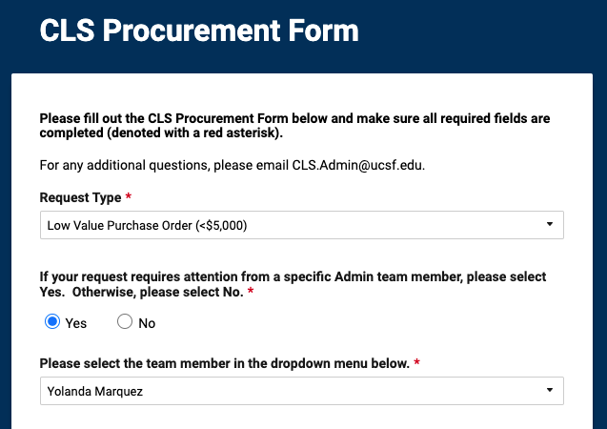
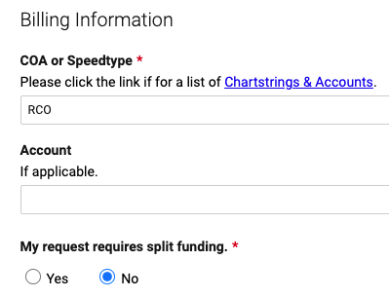
Funding and Purchasing Guidelines
PO Request Form
CLS Admin Purchase Order (PO) Request Form
Type "RCO" under COA or Speedtype

Slide 35
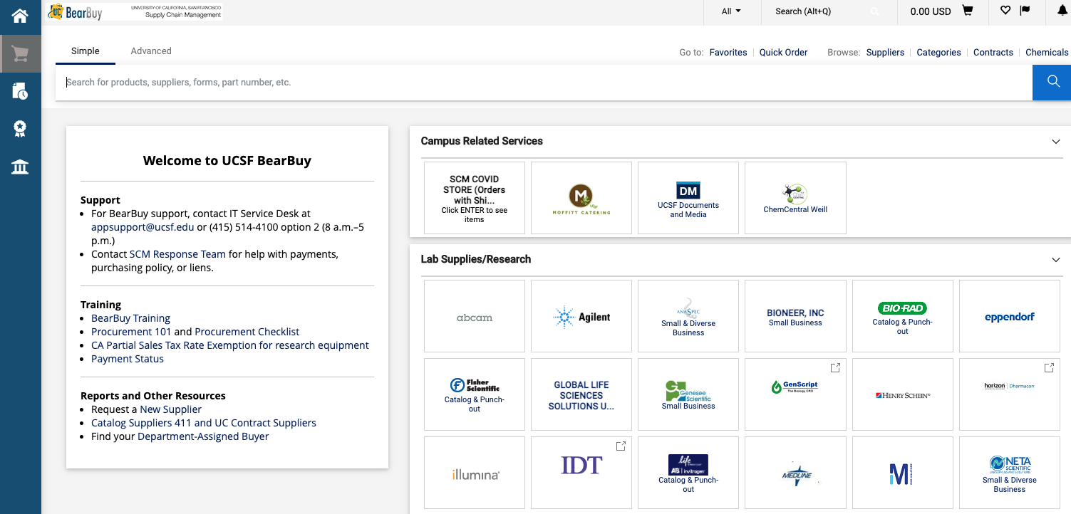
Funding and Purchasing Guidelines
Bear Buy
UCSF campus e-Procurement system for purchasing goods and services
Access through MyAccess.ucsf.edu

Slide 36
Funding and Purchasing Guidelines
Once funding is approved, staff organizations are required to submit their expense requests in BearBuy.
Requests need to be submitted at least two weeks in advance of event date
Request as follows:
Log in to My Access>Bear Buy
Bear Buy
Title the Cart with RCO Name, Event, Date: Ex. “Visuals Arts Club-Virtual Art Show-2020_10_03”
Click on Proceed to Check out
Remove any previous Funding
In Internal Notes and Attachments
Attach names of attendees Excel or CSV.
Publicity: Ex. Flyer
Click on Assign Cart put at the top
Select Search for an Assignee button and click on Search for Assignee, input last and first name: Marquez, Yolanda
Notes:
REVIEW: https://coronavirus.ucsf.edu/events
Bear Buy can still be accessed to purchase items for a virtual event.
When the COVID-19 interim policy has been lifted the following will apply:
ordering food, please reference: https://supplychain.ucsf.edu/meeting-and-entertainment-expenses#
And, scroll down to “Maximum Meal Expenses"

Slide 37
Funding and Purchasing Guidelines
How to Make a Purchase When Vendor IS on BearBuy
Obtain a quote from the vendor
Provide the quote to Yolanda Marquez (Yolanda.Marquez@ucsf.edu) which she will use to generate a Purchase Order (PO)
Supply Chain Management (SCM) will process the PO request and will email Yolanda the PO# that is generated. The vendor will also get an email with the PO# and how to register for Transcepta
Ask the vendor to submit an invoice for payment via Transcepta
*Do not try to open a PO through BearBuy, information needs to be sent to Yolanda
*BearBuy is only for supply (general purchases, supplies, etc.) and NOT giftcards
*For POs, for America to Go orders, send Yolie the info so she can process it

Slide 38
Funding and Purchasing Guidelines
How to Make a Purchase When Vendor IS NOT on BearBuy
Email Yolanda Marquez (Yolanda.Marquez@ucsf.edu) to inform that grantee will be adding vendor to BearBuy
The vendor must fill out a UCSF Substitute W-9 and email the completed form to vendors@ucsf.edu
Obtain a quote from the vendor (can happen at the same time as Step 2)
Provide the quote to Yolanda which she will use to generate a Purchase Order (PO)
Supply Chain Management (SCM) will process the PO request and will email Yolanda the PO# that is generated. The vendor will also get an email with the PO# and how to register for Transcepta
Ask the vendor to submit an invoice for payment via Transcepta

Slide 39
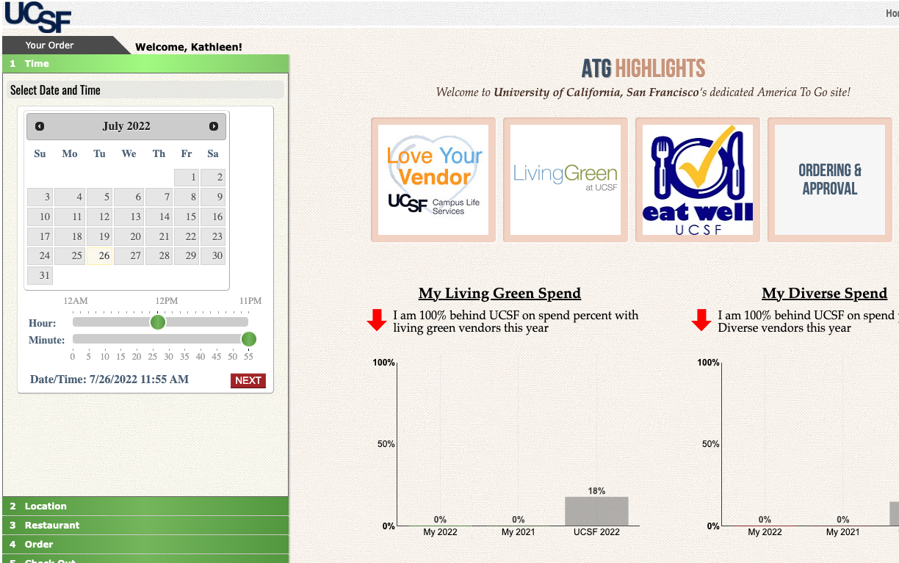
Funding and Purchasing Guidelines
America To Go and Moffitt Catering
Found in BearBuy
Ordering for food catering
Go to America To Go or Moffitt sections to see the menus
Fill out CLS Procurement Form (slide 34)
Make sure to include detailed building, address, room number, time, date, etc. in Delivery Instructions
Need Onsite Contact name and number
Attach screenshot of what you want to purchase

Slide 40
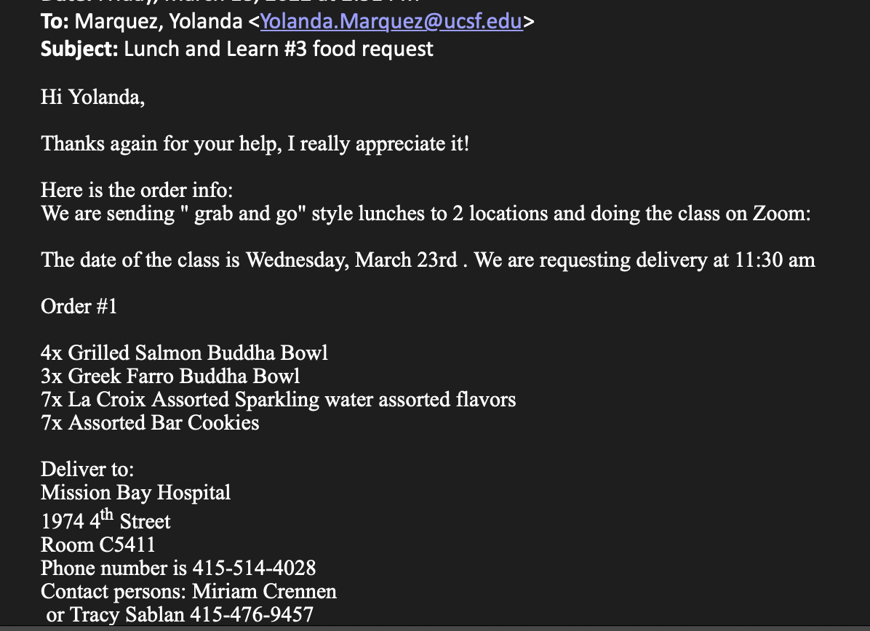
Funding and Purchasing Guidelines
America To Go and Moffitt Catering

Slide 41
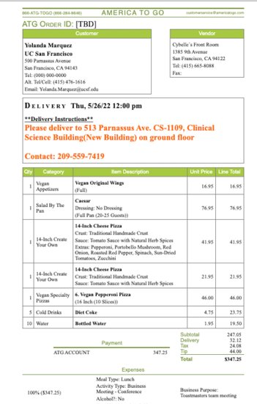
Funding and Purchasing Guidelines​
America To Go

Slide 42
Final Reminders

Slide 43
Campus Policies
Please review all policies which pertain to RCOs and campus activities, including but not limited to:
https://coronavirus.ucsf.edu/events
Educational Technology Services Room Rental Policy
University of California Policies Applying to Campus Activities, Organizations, and Students
Use of University Name, Seal, Logo and Brand Identity
Alcohol Policy
Fundraising Guidelines
Fire Marshall Guidelines for Special Use Areas
EH&S Guidelines for Food Service
Requesting an Honorarium Payment
Meeting and Entertainment Expenses
Please note: Other policies may apply
Notes:
https://coronavirus.ucsf.edu/events
https://edtech.ucsf.edu/rules-and-policieshttps://studentlife.ucsf.edu/policies
http://policies.ucsf.edu/policy/050-13
http://policies.ucsf.edu/policy/200-31
http://studentlife.ucsf.edu/policies/fundraising-guidelines
https://ehs.ucsf.edu/fire-life-safety-0
https://www.cdc.gov/foodsafety/index.html
https://supplychain.ucsf.edu/requesting-honorarium-payment
https://supplychain.ucsf.edu/meeting-and-entertainment-expenses#

Slide 44
Every Staff RCO should be aware
Any RCO that does not adhere to campus policies could have RCO registration, event request, or event funding revoked.
You may not get reimbursed if you purchase items from your own funding sources without prior approval

Slide 45
Questions?
If you have any questions regarding staff RCOs, please reach out to
CLS Wellness and Community, who is happy to help support your Staff RCO
WellnessandCommunity@ucsf.edu

